Slide 1
Azure Time Series Insights Overview
Arturo Quiroga
Sr. Cloud Solutions Architect (CSA)
Microsoft - Canada

Slide 2


Microsoft’s comprehensive IoT product portfolio
Azure IoT Priority Verticals
Manufacturing
Retail
Agriculture
Energy
Smart Cities
Healthcare
Transportation
Azure IoT Central
(SaaS)
Azure IoT Reference Architecture & Accelerators (PaaS)
Dynamics Connected
Field Service
(SaaS)
Azure IoT Solutions
Azure Security
Center for IoT
Azure IoT Hub
Azure IoT Hub Device Provisioning Service
Azure Digital Twins
Azure Time Series Insights
Azure Maps
Azure Stream Analytics
Azure Cosmos DB
Azure AI
Azure Cognitive Services
Azure ML
Azure Logic Apps
Azure Active Directory
Azure Monitor
Azure DevOps
Power BI
Azure Data Share
Azure Spatial Anchors
Azure
Services for IoT
Azure RTOS
Azure Sphere
Azure IoT Device SDK
Azure IoT Edge
Data Box Edge
Windows IoT
Azure Certified for IoT—Device Catalog
Azure Stream Analytics
Azure Storage
Azure ML
Azure SQL
Azure Functions
Azure Cognitive Services
IoT & Edge
Device Support

Slide 3
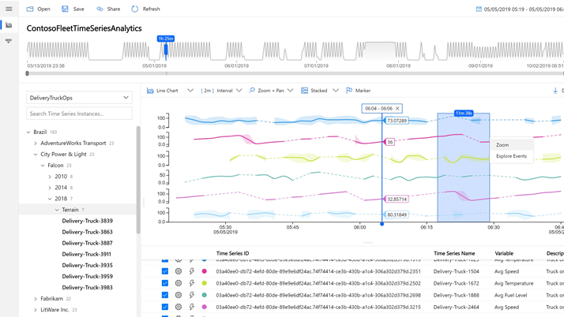







Azure Time Series Insights (TSI)
A Serverless, Fully Managed Platform as a Service (PaaS) Solution Built for IoT
Ingest, process, store, and query highly contextualized, time-series-optimized, IoT-scale data
Built in rich User Experience for ad-hoc queries and exploration
Rich analytics APIs for ad-hoc exploration and operational intelligence
JavaScript control library for building custom analytics apps on the TSI platform
Turn data into decisions with actionable real-time IoT insights
Notes:
Positioning TSI - what does it offer
Ingest pipeline
Warm and cold
Query with multiple aggregates and scalar functions
View with dashboard
Parquet storage - own the data - take data out and use it in other system (databricks)
Visualizations, standard deviations,
Contextualize and author a model
JavaScript SDK - can bring in related datasets, build own custom UI
PAYG - start small, pay as you grow
Scale with you

Slide 4
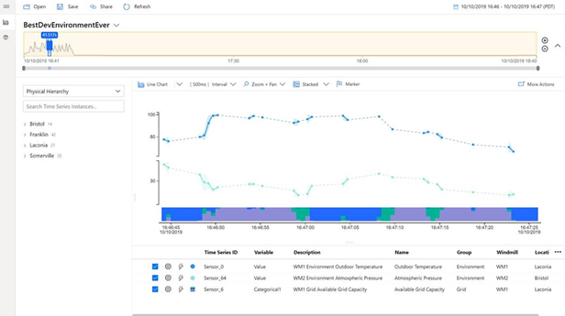

Azure Time Series Insights
Key Capabilities
Multi layered storage with warm and cold analytics support allowing customers to route data to warm store for interactive analytics over short timespans and operational intelligence over decades of historical data
Flexible data platform that allows customers to take data stored in open source Apache Parquet to other advanced data solutions such as Spark, Databricks, for predictive maintenance, machine learning and AI
Rich query APIs and user experience to support interpolation, scalar and aggregate functions, categorical variables, scatter plots, and time shifting of time series signals for in-depth analysis.
Enterprise grade scale and performance at all layers of the solution to support customers’ industrial IoT solution needs
Rich extensibility through PowerBI connector to enable customers to take their time series queries directly into PowerBI for a unified BI and analytics view
Notes:
IoT Hub > stream into TSI
Stream analytics often used + triggering outside via functions
In TSI
Customer creates hierarchy
Explore data via PBI, PBI connector
TSI Explorer
Or build custom apps via JavaScript
For more advanced analytics - use Databricks to take data out (todo in future there will be a Spark connector, today it's Parquet directly - later on easier to parse the time series data)

Slide 5



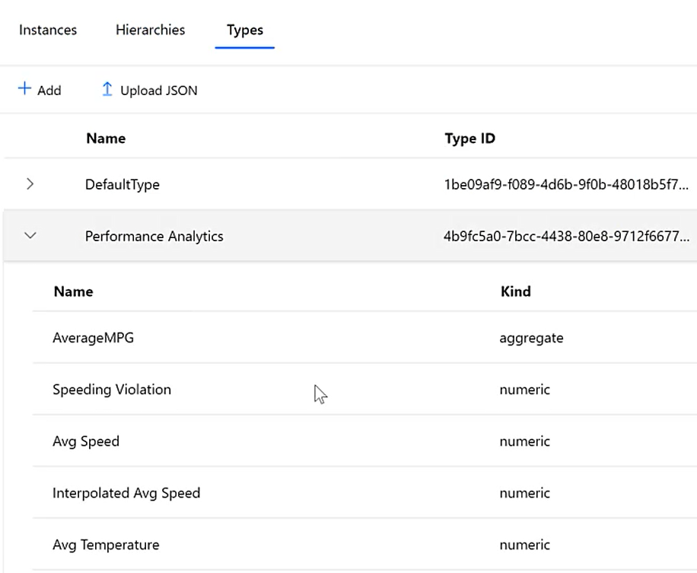
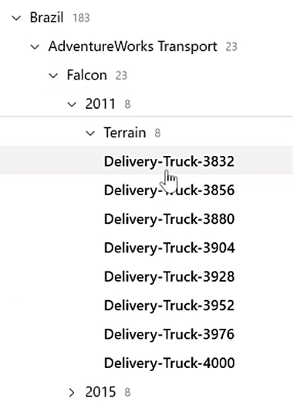
Azure Time Series Insights (TSI)
A Serverless, Fully Managed Platform as a Service (PaaS) Solution Built for IoT
NEW
Capabilities
Time-Series Model For Structuring Data
Multi-layered Storage Warm & Cold
Open & Interoperable via Apache Parquet
Rich Query API
Power BI Connector for Unified BI and Analytics

Slide 6
Azure Time Series Insights (TSI)
A Serverless, Fully Managed Platform as a Service (PaaS) Solution Built for IoT
Time-Series Model For Structuring Data
Multi-layered Storage Warm & Cold
Open & Interoperable via Apache Parquet
Rich Query API
Power BI Connector for Unified BI and Analytics
Warm storage
Built-in
Cold storage
Bring your own

Slide 7
Azure Time Series Insights (TSI)
A Serverless, Fully Managed Platform as a Service (PaaS) Solution Built for IoT
Time-Series Model For Structuring Data
Multi-layered Storage Warm & Cold
Open & Interoperable via Apache Parquet
Rich Query API
Power BI Connector for Unified BI and Analytics
Warm storage
Built-in
Cold storage
Bring your own
Azure Blob Storage
Azure Data Lake Storage Gen2
Sub-second query speeds
Recent data
Multi-second query speeds
Decades of data

Slide 8
Azure Time Series Insights (TSI)
A Serverless, Fully Managed Platform as a Service (PaaS) Solution Built for IoT
Time-Series Model For Structuring Data
Multi-layered Storage Warm & Cold
Open & Interoperable via Apache Parquet
Rich Query API
Power BI Connector for Unified BI and Analytics
Azure Blob Storage
Azure Data Lake Storage Gen2
Sub-second query speeds
Recent data
Multi-second query speeds
Decades of data

Slide 9
Azure Time Series Insights (TSI)
A Serverless, Fully Managed Platform as a Service (PaaS) Solution Built for IoT
Time-Series Model For Structuring Data
Multi-layered Storage Warm & Cold
Open & Interoperable via Apache Parquet
Rich Query API
Power BI Connector for Unified BI and Analytics
Rich data interoperability
Open Source Analytics
Azure Machine Learning
Azure Synapse Analytics
Sub-second query speeds
Recent data
Multi-second query speeds
Decades of data

Slide 10
Azure Time Series Insights (TSI)
A Serverless, Fully Managed Platform as a Service (PaaS) Solution Built for IoT
Time-Series Model For Structuring Data
Multi-layered Storage Warm & Cold
Open & Interoperable via Apache Parquet
Rich Query API
Power BI Connector for Unified BI and Analytics
Query holistically across warm and cold storage
Including support for
Interpolation
Scalar functions
Aggregate functions
Categorical variables
Scatter plots
Time shifting
Sub-second query speeds
Recent data
Multi-second query speeds
Decades of data

Slide 11
Azure Time Series Insights (TSI)
A Serverless, Fully Managed Platform as a Service (PaaS) Solution Built for IoT
Time-Series Model For Structuring Data
Multi-layered Storage Warm & Cold
Open & Interoperable via Apache Parquet
Rich Query API
Power BI Connector for Unified BI and Analytics
Power BI Support
Sub-second query speeds
Recent data
Multi-second query speeds
Decades of data

Slide 12
Demo
Notes:
TSI environment
Javascript: https://tsiclientsample.azurewebsites.net/

Slide 13



Azure Time Series Insights pay as you go high level architecture
Collect
Store
Model
Analyze
Real Time Processing engine
</>
COLD STORE ADLS Gen 2/ Azure Blog
Azure Event
Hub
TIME SERIES MODEL
Time Series Query API
TIME SERIES INSIGHTS EXPLORER
POWER BI CONNECTOR
3rd PARTY APPS
Azure IOT
Hub
Azure Digital Twins
Stream processing
engine
WARM STORE
</>
TSM Update API
Timeseries data
API requests/returns
AI/ML workflow
Notes:
Once Time Series Insights is up and running, new data is synced continuously via the TSM Update API, providing you near real-time visualizations of your streaming data. You can also send logical twin models and device twin models directly to the TSM Update API for seamless integration into the Time Series Model.
Transition: Does Time Series Insights support AI and machine learning? (click)

Slide 14
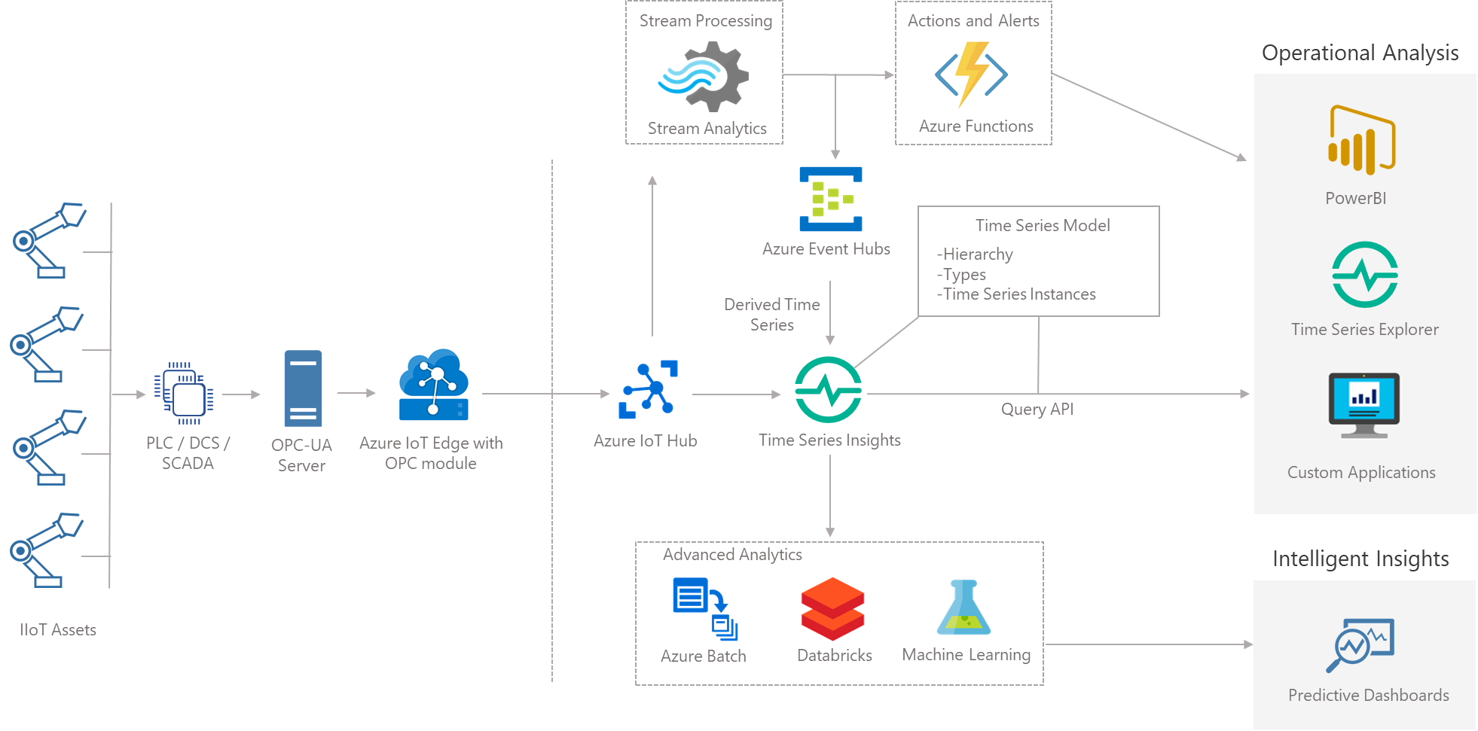
Operational intelligence and process insights
Core Scenarios: Data Exploration, Operational Intelligence and Advanced Analytics
No upfront data preparation
Connect to billions of events in Azure IoT Hub or Azure Event Hub, and visualize & analyze billions of events to spot anomalies and discover hidden trends in your data
Describe model asset data using time series model
Upload the model with variables, types, hierarchies, instances along with device telemetry data
Use highly scalable, performant, cost-effective queries to trend decades of device data to drive operational intelligence
Enable monitoring of the health, usage, and performance of your equipment, at scale, by connecting Time Series Insights to other data services for a variety of business and analytics scenarios

Slide 15
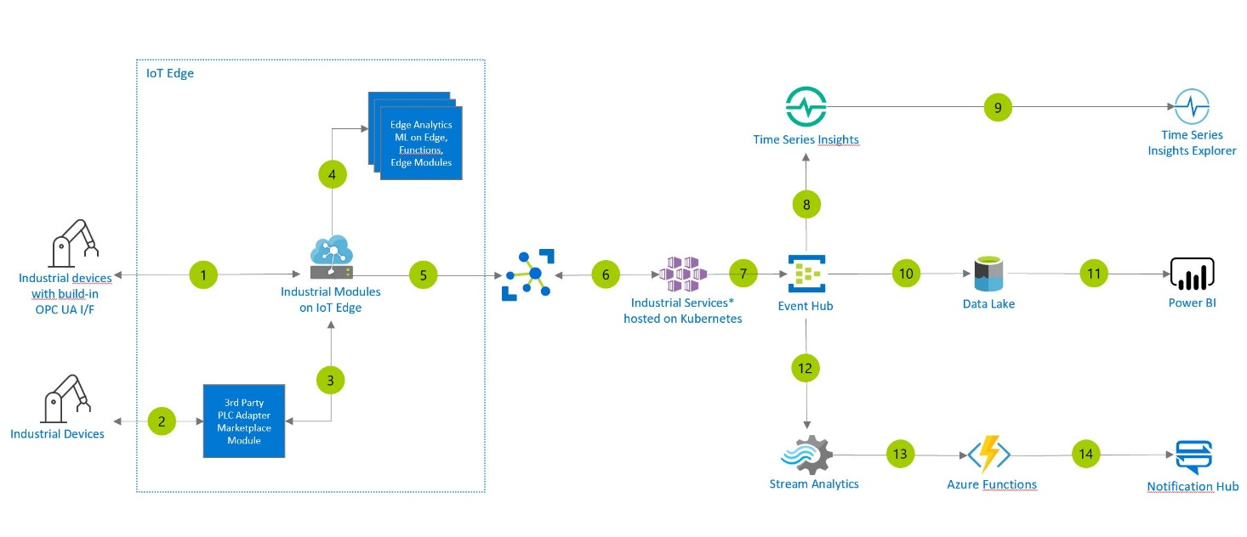
Condition monitoring
Condition Monitoring for Industrial IoT - Azure Solution Ideas | Microsoft Docs
Notes:
See also Azure Industrial IoT guidance - Azure Application Architecture Guide | Microsoft Docs

Slide 16






TSI High Level Architecture
COLLECT
Device Telemetry
Time Series IDs
Data Processing Engine
PROCESS
Time Series Routed to Warm / Cold
Time Series Model Store
(Instances, Types, Vars, Hierarchy)
Warm Store
(up to 31d data retention)
Cold Store
(infinite data retention)
Time Series Model Update API
STORE
Connect to Data Source
Query across Warm / Cold
Model Query
Query API
Analytics and Model Query
ANALYZE
TSI Explorer
3rd Party App
Model Update Sync
Public Preview

Slide 17
TSI High Level Architecture
Post-GA
ADT
IoT Hub
Event Hub
Logical twin model
Device twin model
Logical twin telemetry
Device telemetry
Unmodeled timeseries
Derived timeseries
Post-GA
Post-GA
TSM Inference
Stream Processing Engine
Calc Engine
Types, instances,
Time Series ID
Timeseries data
Bulk Upload
hierarchies
Data Deletion
Post-GA
TSM Update API
Time Series
Warm Store
Cold Store
Job Engine
Model
(up to 31d data retention )
(BYO GPv1, GPv2,
(Managed Spark)
ADLSg2)
Interactive query
Batch query
Model query
Time Series Query API
BYO
Time Series Model
authoring, sync
Analytics and model query
TSI Explorer
3
rd
party
apps
MICROSOFT CONFIDENTIAL

Slide 18
Time Series Model
Types
Hierarchies
Instances
Types define variables associated with a Time series ID.
Users create ‘types’ by defining a friendly name, description, and associated variables. These are used for computation
Hierarchies defined by HierarchyIDs organize instances by specifying property names and their relationships
Hierarchies have paths, a top-down parent-child order user wants to create.
Instance describes a time series, and must have only one Type
Event count is the default type
Instance are mapped to one more hierarchies, they inherit all properties from the hierarchies

Slide 19
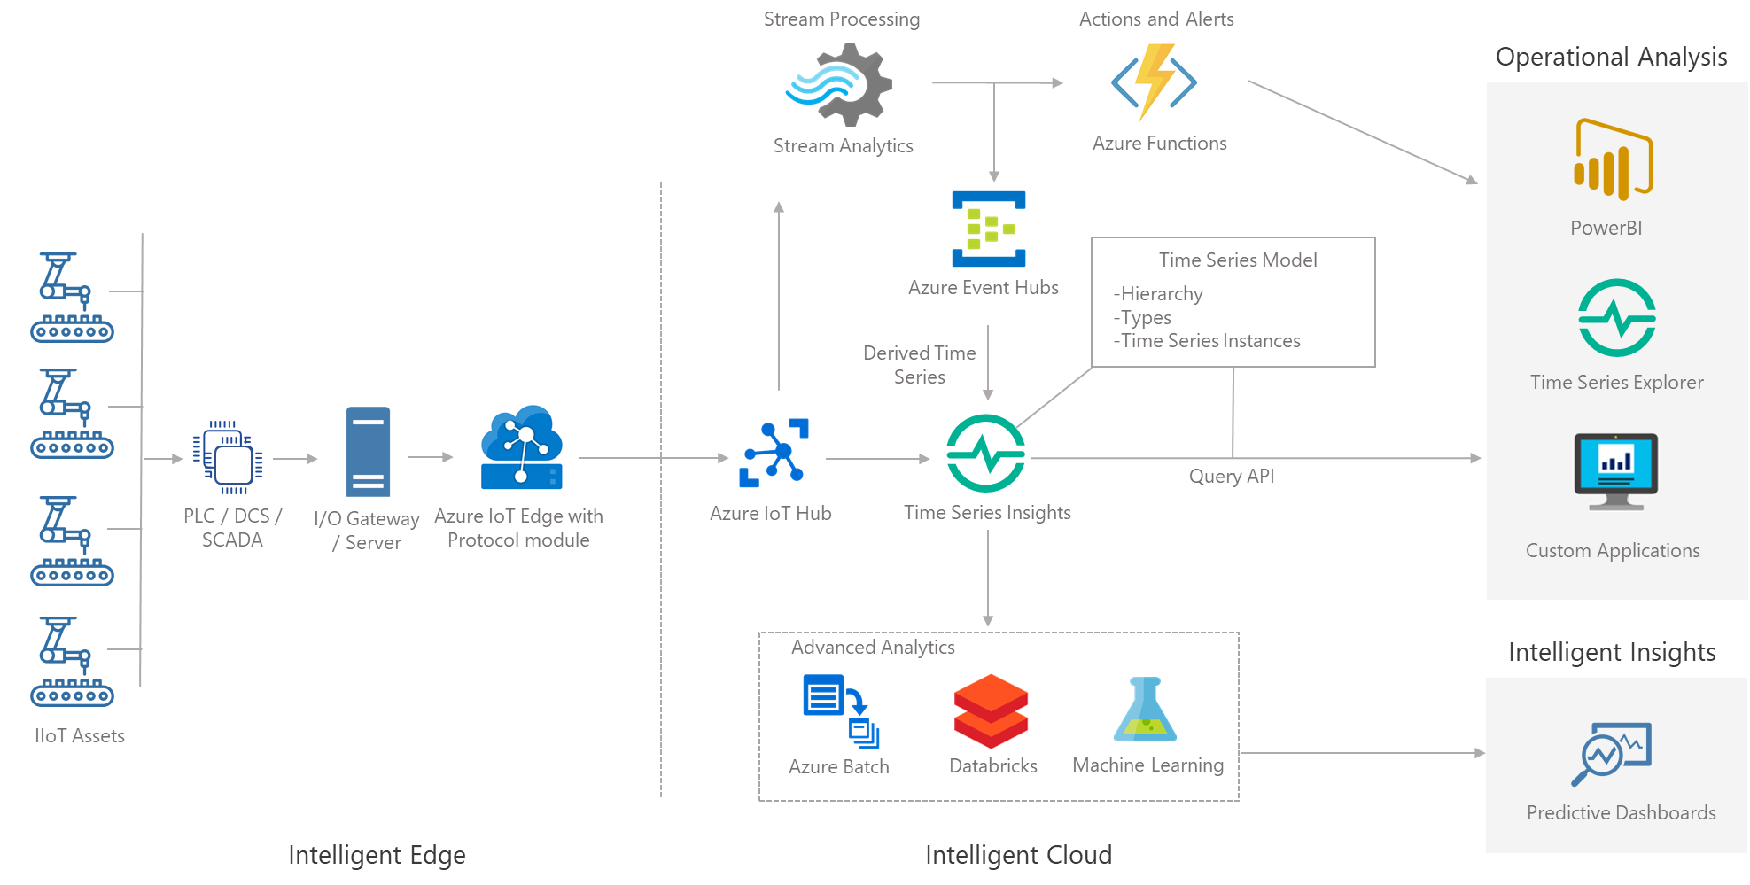
Case Study: Manufacturing
Scenario: Operational Intelligence and Process Improvement

Slide 20
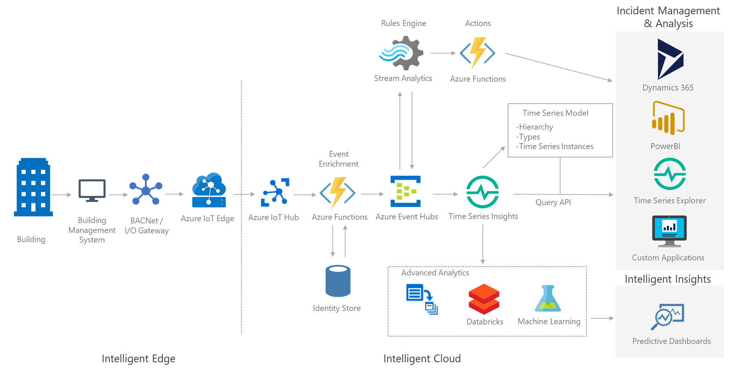
Case Study: Smart Buildings
Scenario: Anomaly detection and fault detection

Slide 21
Key Customer Use Cases
Connect and Migrate
Connect to existing industrial systems (SCADA, OPC server-based) to move or stream data to the cloud
Bulk ingest data (and model) from on-prem historians – AspenTech, OSI Pi, Wonderware, custom IoT platforms
Ingest
Ingest data at rates as low as 5 MBPS to 15MBPS with 10s of millions of datapoints/tags per day from multiple data sources
Predominantly OPC UA data, with custom processing in the pipeline for massaging, conversion, etc.
Build/Migrate and Store Context
Map existing asset models / digital twins to analytical model (TSM)
Expect to store 1mil to 4mil tags over time
Store Data
Warm storage for fresh data for interactive query, cold storage for historical data for operational intelligence
Analyze
Ad hoc exploration, operational analytics, process engineering, business intelligence
AI and ML solutions to build machine learning models, and store it back in TSI for scoring
Extend and Customize
Integration with existing data solutions – PowerBI, Spark, AML, custom, 3rd party
Custom apps using TSI’s JS SDK
Role-based access control for fine-grained access to data and analytics
Analytics on the edge

Slide 22
Resources
Product website: https://azure.microsoft.com/en-us/services/time-series-insights/
Documentation: https://docs.microsoft.com/en-us/azure/time-series-insights/
Tutorial: https://docs.microsoft.com/en-us/azure/time-series-insights/time-series-insights-update-create-environment
Product video: https://channel9.msdn.com/Shows/Internet-of-Things-Show/Azure-Time-Series-Insights-e2e-solution-for-industrial-IoT-analytics
Public Preview Blog: https://azure.microsoft.com/en-us/blog/advancing-industrial-iot-capabilities-in-azure-time-series-insights/
Pricing: https://azure.microsoft.com/en-us/pricing/details/time-series-insights/
Try Azure Time Series Insights!
Demo environment: https://docs.microsoft.com/en-us/azure/time-series-insights/time-series-insights-update-quickstart
Time Series Insights Explorer: https://insights.timeseries.azure.com/preview

Slide 23
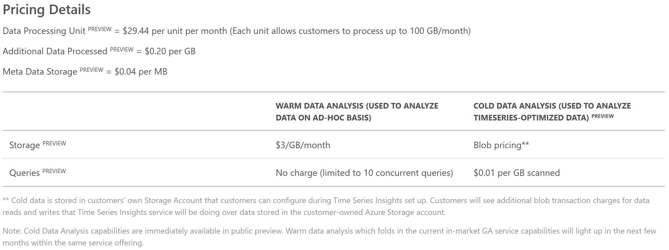
Azure Time Series Insights PAYG Pricing
MICROSOFT CONFIDENTIAL

